Slide 1
Discrete Mathematics
5th edition, 2001
Chapter 1
Logic and proofs

Slide 2
These Notes
Originally provided by the author
You will find my traces here and there
You can download them from the site referenced in the textbook, and the modify your hardcopies as necessary during class
I will upload finished chapters online

Slide 3
Logic
Logic = the study of correct reasoning
Use of logic
  In mathematics:
    to prove theorems
  In computer science:
    to prove that programs do what they are supposed to do

Slide 4
…Logic
Logic focuses on the relationship among statements a.o.t. the content of any particular statement. For example:
My watch is digital
All digital devices run on batteries
Therefore, my watch runs on batteries
Note that logic is not concerned with the truth of the first two statements. But if they were true, then the inference is true

Slide 5
Section 1.1 Propositions
A proposition is a statement or sentence that can be determined to be either true or false.
It’s usually declared as a declarative sentence (a.o.t. a question, command, etc.)

Slide 6
Section 1.1 Propositions
Examples. Which are the propositions?
  The only positive integers that divide 23 are 1 and itself
  For every positive integer n, there is a prime number > n
  Buy tickets to spend vacation in Malaysia
  Earth is the only planet in the universe that has life
  I wish I were a black belt holder

Slide 7
…Section 1.1 Propositions
  The only positive integers that divide 23 are 1 and itself. Yes
  For every positive integer n, there is a prime number > n. Yes
  Buy tickets to spend vacation in Malaysia. No
  Earth is the only planet in the universe that has life. Yes
  I wish I were a black belt holder. No

Slide 8
Connectives
If p and q are propositions, new compound propositions can be formed by using connectives
Most common connectives:
  Conjunction AND. Symbol ^
  Inclusive disjunction OR Symbol v
  Exclusive disjunction OR Symbol v
  Negation NOT Symbol ~
  Implication Symbol →
  Double implication Symbol ↔

Slide 9
Truth table of conjunction
The truth values of compound propositions can be described by truth tables.
Truth table of conjunction
p ^ q is true only when both p and q are true.
p | q | p ^ q
T | T | T
T | F | F
F | T | F
F | F | F

Slide 10
Example
Let p = “Tigers are wild animals”
Let q = “Chicago is the capital of Illinois”
p ^ q = "Tigers are wild animals and Chicago is the capital of Illinois"
p ^ q is false. Why?
Note that p and q need not be related in any way!

Slide 11
Truth table of disjunction
The truth table of (inclusive) disjunction is
p ∨ q is false only when both p and q are false
  Example: p = "John is a programmer", q = "Mary is a lawyer"
  p v q = "John is a programmer or Mary is a lawyer"
p | q | p v q
T | T | T
T | F | T
F | T | T
F | F | F

Slide 12
Exclusive disjunction
“Either p or q” (but not both), in symbols p ∨ q
p ∨ q is true only when p is true and q is false, or p is false and q is true.
  Example: p = "John is programmer, q = "Mary is a lawyer"
  p v q = "Either John is a programmer or Mary is a lawyer"
p | q | p v q
T | T | F
T | F | T
F | T | T
F | F | F

Slide 13
Negation
Negation of p: in symbols ~p
~p is false when p is true, ~p is true when p is false
  Example: p = "John is a programmer"
  ~p = "It is not true that John is a programmer"
p | ~p
T | F
F | T

Slide 14
More compound statements
Let p, q, r be simple statements
We can form other compound statements, such as
  (p∨q)^r
  p∨(q^r)
  (~p)∨(~q)
  (p∨q)^(~r)
  and many others…

Slide 15
Example
Let p = There is a hurricane
Let q = It is raining
Let r = The sun is shining
Now, represent the proposition:
  Either there is a hurricane and it is not true that the sun is shining, or it is raining

Slide 16
Example
Let p = There is a hurricane
Let q = It is raining
Let r = The sun is shining
Now, represent the proposition:
  Either there is a hurricane and it is not true that the sun is shining, or it is raining
(p^~r)∨q

Slide 17
The truth table of (p^~r)∨q
p | q | r | (p^~r)∨q
T | T | T | T
T | T | F | T
T | F | T | F
T | F | F | T
F | T | T | T
F | T | F | T
F | F | T | F
F | F | F | F

Slide 18
1.2 Conditional propositions and logical equivalence
A conditional proposition is of the form
“If p then q”
In symbols: p → q
Example:
  p = " John is a programmer"
  q = " Mary is a lawyer "
  p → q = “If John is a programmer then Mary is a lawyer"

Slide 19
Truth table of p → q
p | q | p → q
T | T | T
T | F | F
F | T | T
F | F | T
p → q is true when both p and q are true
or when p is false

Slide 20
Example on p → q
p = I run fast
q = I win the race
p | q | p → q
T | T | T
T | F | F
F | T | T
F | F | T

Slide 21
Hypothesis and conclusion
In a conditional proposition p → q,
p is called the antecedent or hypothesis
q is called the consequent or conclusion
If "p then q" is considered logically the same as "p only if q“
Make sure you comprehend discussion on Page 9

Slide 22
Necessary and sufficient
A necessary condition is expressed by the conclusion.
A sufficient condition is expressed by the hypothesis.
  Example:
If John is a programmer then Mary is a lawyer"
  Necessary condition: “Mary is a lawyer”
  Sufficient condition: “John is a programmer”

Slide 23
Logical equivalence
Two propositions are said to be logically
equivalent if their truth tables are identical.
Example: ~p ∨ q is logically equivalent to p → q
p | q | ~p ∨ q | p → q
T | T | T | T
T | F | F | F
F | T | T | T
F | F | T | T

Slide 24
Converse
The converse of p → q is q → p
These two propositions
are not logically equivalent
p | q | p → q | q → p
T | T | T | T
T | F | F | T
F | T | T | F
F | F | T | T

Slide 25
Contrapositive
The contrapositive of the proposition p → q is ~q → ~p.
They are logically equivalent.
p | q | p → q | ~q → ~p
T | T | T | T
T | F | F | F
F | T | T | T
F | F | T | T

Slide 26
Double implication
The double implication “p if and only if q” is defined in symbols as p ↔ q
p ↔ q is logically equivalent to (p → q)^(q → p)
p | q | p ↔ q | (p → q) ^ (q → p)
T | T | T | T
T | F | F | F
F | T | F | F
F | F | T | T

Slide 27
Tautology
A proposition is a tautology if its truth table contains only true values for every case
  Example: p → p v q
p | q | p → p v q
T | T | T
T | F | T
F | T | T
F | F | T

Slide 28
Contradiction
A proposition is a tautology if its truth table contains only false values for every case
  Example: p ^ ~p
p | p ^ (~p)
T | F
F | F

Slide 29
De Morgan’s laws for logic
The following pairs of propositions are logically equivalent:
  ~ (p ∨ q) and (~p)^(~q)
  ~ (p ^ q) and (~p) ∨ (~q)

Slide 30
1.3 Quantifiers
A propositional function P(x) is a statement involving a variable x over domain D
For example:
  P(x): 2x is an even integer
x is an element of a set D
  For example, x is an element of the set of integers
D is called the domain of P(x)

Slide 31
Domain of a propositional function
In the propositional function
P(x): “2x is an even integer”,
the domain D of P(x) must be defined, for
instance D = {integers}.
D is the set where the x's come from.

Slide 32
For every and for some
Most statements in mathematics and computer science use terms such as for every and for some.
For example:
  For every triangle T, the sum of the angles of T is 180 degrees.
  For every integer n, n is less than p, for some prime number p.

Slide 33
Universal quantifier
One can write P(x) for every x in a domain D
  In symbols: ∀x P(x)
∀ is called the universal quantifier

Slide 34
Truth of as propositional function
The statement ∀x P(x) is
  True if P(x) is true for every x ∈ D
  False if P(x) is not true for some x ∈ D
Example: Let P(n) be the propositional function n² + 2n is an odd integer
∀n ∈ D = {all integers}
P(n) is true only when n is an odd integer, false if n is an even integer.

Slide 35
Existential quantifier
For some x ∈ D, P(x) is true if there exists
an element x in the domain D for which P(x) is
true. In symbols: ∃x, P(x)
The symbol ∃ is called the existential quantifier.

Slide 36
Counterexample
The universal statement ∀x P(x) is false if ∃x ∈ D such that P(x) is false.
The value x that makes P(x) false is called a counterexample to the statement ∀x P(x).
  Example: P(x) = "every x is a prime number", for every integer x.
  But if x = 4 (an integer) this x is not a prime number. Then 4 is a counterexample to P(x) being true.

Slide 37
Generalized De Morgan’s laws for Logic
If P(x) is a propositional function, then each pair of propositions in a) and b) below have the same truth values:
a) ~(∀x P(x)) and ∃x: ~P(x)
"It is not true that for every x, P(x) holds" is equivalent to "There exists an x for which P(x) is not true"
b) ~(∃x P(x)) and ∀x: ~P(x)
"It is not true that there exists an x for which P(x) is true" is equivalent to "For all x, P(x) is not true"

Slide 38
Summary of propositional logic
In order to prove the universally quantified statement ∀x P(x) is true
  It is not enough to show P(x) true for some x ∈ D
  You must show P(x) is true for every x ∈ D
In order to prove the universally quantified statement ∀x P(x) is false
  It is enough to exhibit some x ∈ D for which P(x) is false
  This x is called the counterexample to the statement ∀x P(x) is true

Slide 39
De Morgan’s laws
~ (p ∨ q) ↔ (~p)^(~q)
~ (p ^ q) ↔ (~p) ∨ (~q)
~(∀x P(x)) ↔ ∃x: ~P(x)
~(∃x P(x)) ↔ ∀x: ~P(x)
~ (=, ~=) ↔ (~=, =)
~ (<, <=, >, >=) ↔ (>=, >, <=, <)

Slide 40
1.4 Proofs
A mathematical system consists of
  Undefined terms
  Definitions
  Axioms

Slide 41
Undefined terms
Undefined terms are the basic building blocks of a mathematical system. These are words that are accepted as starting concepts of a mathematical system.
  Example: in Euclidean geometry we have undefined terms such as
    Point
    Line

Slide 42
Definitions
A definition is a proposition constructed from undefined terms and previously accepted concepts in order to create a new concept.
  Example. In Euclidean geometry the following are definitions:
  Two triangles are congruent if their vertices can be paired so that the corresponding sides are equal and so are the corresponding angles.
  Two angles are supplementary if the sum of their measures is 180 degrees.

Slide 43
Axioms
An axiom is a proposition accepted as true without proof within the mathematical system.
There are many examples of axioms in mathematics:
  Example: In Euclidean geometry the following are axioms
    Given two distinct points, there is exactly one line that contains them.
    Given a line and a point not on the line, there is exactly one line through the point which is parallel to the line.

Slide 44
Theorems
A theorem is a proposition of the form p → q which must be shown to be true by a sequence of logical steps that assume that p is true, and use definitions, axioms and previously proven theorems.

Slide 45
Lemmas
A lemma is a small theorem which is used to prove a bigger theorem. That is, if it wasn’t for the bigger theorem we need to prove, it become of no interest by itself
  Example: if n is a positive integer, then either n-1 is positive, or n-1=0
  Not of interest in its own right, but see Ex. 1.4.6

Slide 46
Corollaries
A corollary is a theorem that can be proven to be a logical consequence of another theorem
  Example from Euclidean geometry: "If the three sides of a triangle have equal length, then its angles also have equal measure."

Slide 47
Types of proof
A proof is a logical argument that consists of a series of steps using propositions in such a way that the truth of the theorem is established.
Direct proof: p → q
  A direct method of attack that assumes the truth of proposition p, axioms and proven theorems so that the truth of proposition q is obtained.
Logic is a tool for the analysis of proofs

Slide 48
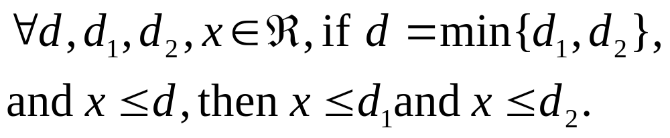
Example
Prove that

Slide 49
…Example
From the definition, it follows that
  d <= d1 and d <= d2
  From x <= d and d <= d1, we derive that x <= d1
  From x <= d and d <= d2, we derive that x <= d2
Therefore what? The conclusion

Slide 50
Indirect proof
  The method of proof by contradiction of a theorem p → q consists of the following steps:
    1. Assume p is true and q is false
    2. Show that ~p is also true.
    3. Then we have that p ^ (~p) is true.
    4. But this is impossible, since the statement p ^ (~p) is always false. There is a contradiction!
    5. So, q cannot be false and therefore it is true.
  OR: show that the contrapositive (~q)→(~p) is true.
    Since (~q) → (~p) is logically equivalent to p → q, then the theorem is proven.

Slide 51
Example
  " x, y Î R, if x + y >= 2, then either x>=1 or y>=1.
  Proof:
    Suppose conclusion is false, then x<1 and y<1
    Therefore, x + y < 1 + 1 = 2
    We have now derived a contradiction p ^ ~p, where
    p: x + y >= 2
    Thus we conclude that the statement is true
  See Ex. 1.4.8

Slide 52
Valid arguments
Deductive reasoning: the process of reaching a conclusion q from a sequence of propositions p₁, p₂, …, p_{n}.
The propositions p₁, p₂, …, p_{n} are called premises or hypothesis.
The proposition q that is logically obtained through the process is called the conclusion.
A deductive argument consists of hypothesis together with the conclusion

Slide 53
…Valid arguments
Any argument that has the form:
If p1 and p2 and … pn, then q
is said to be valid iff pi , i=1, 2, … n is true. In this case, q is also true
Otherwise, it is said to be invalid

Slide 54
Notations
An argument is a sequence of propositions written: or:
p1
p2
.
.
.
pn
--------
\q
p1, p2, …, pn / \q

Slide 55
Example
Determine if p → q, p / \ q is valid
p | q | p → q | p | q
T | T | T | T | T
T | F | F | T | F
F | T | T | F | T
F | F | T | F | F
Note that whenever p → q and p are true, q is true
Therefore, argument is valid
Another way: suppose p → q and p are true, then q must be true, otherwise p → q would be false. Therefore, argument is valid

Slide 56
Example
Let p: I study hard, q: I get A’s, r: I get rich
Now, consider this argument:
if I study hard, then I get A’s
if I don’t get rich, then I don’t get A’s
------------------------------------------------
\ I get rich
First, formulate it
Next, determine whether it’s valid

Slide 57
…Example
p: I study hard, q: I get A’s, r: I get rich
if I study hard, then I get A’s
if I don’t get rich, then I don’t get A’s
------------------------------------------------
\ I get rich
Formulating:
p → q
~r → ~q
------------
\ r

Slide 58
…Example
p: I study hard, q: I get A’s, r: I get rich
p → q
~r → ~q
------------
\ r
If the argument is valid, then whenever p → q and
~r → ~q are true, r must be also true
Construct a truth table and see if such propositions hold

Slide 59
…Example
p | q | p → q | r | ~r → ~q
T | T | T | T | F
T | F | F | T | T
F | T | T | F | T
F | F | T | F | T
Note that when both hypotheses are true, the consequence is false
The argument is therefore invalid

Slide 60
Another Example (from book)
Let p: 2 = 3, q: I ate my hat
Now, consider this argument:
if 2 = 3, then I ate my hat
I ate my hat
------------------------------------------------
\ 2 = 3
So we have: p → q
q
---------
\ p

Slide 61
…Another Example
p | q | p → q | p
T | T | T | T
T | F | F | T
F | T | T | F
F | F | T | F
p → q
q
---------
\ p
Inspect the third row: hypotheses are true but conclusion is false, thus argument is invalid
Another way by avoiding truth table. If argument is valid, then whenever p → q and q are both true, p must also be true. Suppose both hypotheses are true. This is possible if p is false and q is true. In this case, p, the conclusion, is not true. Thus, argument is invalid

Slide 62
Rules of inference (1)
1. Law of detachment or modus ponens
  p → q
  p
  Therefore, q
2. Modus tollens
  p → q
  ~q
  Therefore, ~p

Slide 63
Rules of inference (2)
3. Rule of Addition
  p
  Therefore, p ∨ q
4. Rule of simplification
  p ^ q
  Therefore, p, or
  Therefore, q. Why?
5. Rule of conjunction
  p
  q
  Therefore, p ^ q

Slide 64
Rules of inference (3)
6. Rule of hypothetical syllogism (I know it as transitivity)
  p → q
  q → r
  Therefore, p → r
7. Rule of disjunctive syllogism
  p ∨ q
  ~p
  Therefore, q

Slide 65
Rules of inference for quantified statements
1. Universal instantiation
  ∀ x∈D, P(x)
  d ∈ D
  Therefore P(d)
2. Universal generalization
  P(d) for any d ∈ D
  Therefore ∀x, P(x)
3. Existential instantiation
  ∃ x ∈ D, P(x)
  Therefore P(d) for some d ∈D
4. Existential generalization
  P(d) for some d ∈D
  Therefore ∃ x, P(x)

Slide 66
1.6 Mathematical induction
Useful for proving statements of the form
∀ n ∈ A S(n)
where
  N is the set of positive integers or natural numbers
  A is an infinite subset of N
  S(n) is a propositional function

Slide 67
Mathematical Induction: strong form
Suppose we want to show that for each positive integer n, the statement S(n) is either true or false.
  1. Verify that S(1) is true.
  2. Let n be an arbitrary positive integer. Let i be a positive integer such that i < n.
  3. Show that S(i) true implies that S(i+1) is true, i.e. show S(i) → S(i+1).
  4. Then conclude that S(n) is true for all positive integers n.

Slide 68
Mathematical induction: terminology
Basis step: Verify that S(1) is true.
Inductive step: Assume S(i) is true.
Prove S(i) → S(i+1).
Conclusion: Therefore S(n) is true for all positive integers n.

Slide 69
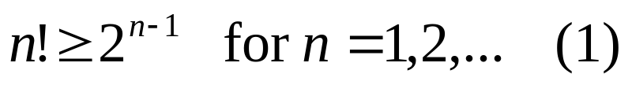
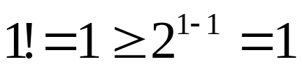
Example
Use induction to show that
Note that:
  0! = 1! = 1
  For n>=2, n! = n.(n-1).(n-2). … .1
  E.g., 5! = 5.4.3.2.1 = 120
1. Basic step: show that n=1 is true. This is easily accomplished since

Slide 70
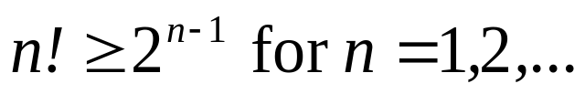
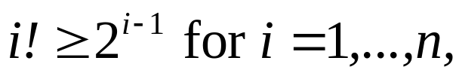
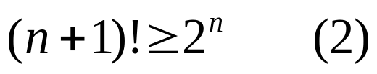

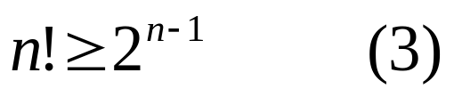

…Example
Use induction to show that
2. Inductive step: show that if
then
Assume that . Then, for i=n, we have
We can relate Eq. (2) and (3) by noting that

Slide 71

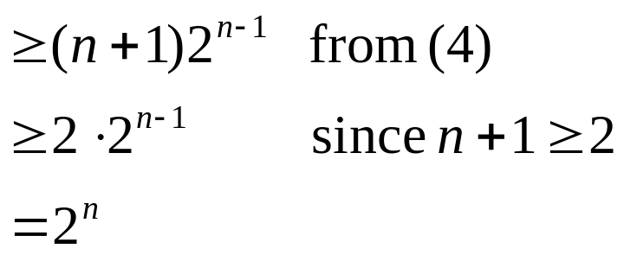
…Example
Use induction to show that
So we have
Therefore, Eq. (3), the inductive step, is true
Since the basis step and inductive step have been verified, it follows from the principle pf MI that Eq.(1) is true for every positive integer n

